Slide 1
Automated Cluster Testing and Optimization
Brad Powell Sr. Security Engineer | CERT

Slide 2
Document Markings
Copyright 2018 Carnegie Mellon University. All Rights Reserved.
This material is based upon work funded and supported by the Department of Homeland Security under Contract No. FA8702-15-D-0002 with Carnegie Mellon University for the operation of the Software Engineering Institute, a federally funded research and development center sponsored by the United States Department of Defense.
The view, opinions, and/or findings contained in this material are those of the author(s) and should not be construed as an official Government position, policy, or decision, unless designated by other documentation.
References herein to any specific commercial product, process, or service by trade name, trade mark, manufacturer, or otherwise, does not necessarily constitute or imply its endorsement, recommendation, or favoring by Carnegie Mellon University or its Software Engineering Institute.
NO WARRANTY. THIS CARNEGIE MELLON UNIVERSITY AND SOFTWARE ENGINEERING INSTITUTE MATERIAL IS FURNISHED ON AN "AS-IS" BASIS. CARNEGIE MELLON UNIVERSITY MAKES NO WARRANTIES OF ANY KIND, EITHER EXPRESSED OR IMPLIED, AS TO ANY MATTER INCLUDING, BUT NOT LIMITED TO, WARRANTY OF FITNESS FOR PURPOSE OR MERCHANTABILITY, EXCLUSIVITY, OR RESULTS OBTAINED FROM USE OF THE MATERIAL. CARNEGIE MELLON UNIVERSITY DOES NOT MAKE ANY WARRANTY OF ANY KIND WITH RESPECT TO FREEDOM FROM PATENT, TRADEMARK, OR COPYRIGHT INFRINGEMENT.
[DISTRIBUTION STATEMENT A] This material has been approved for public release and unlimited distribution. Please see Copyright notice for non-US Government use and distribution.
This material may be reproduced in its entirety, without modification, and freely distributed in written or electronic form without requesting formal permission. Permission is required for any other use. Requests for permission should be directed to the Software Engineering Institute at permission@sei.cmu.edu.
Carnegie Mellon®, CERT® and FloCon® are registered in the U.S. Patent and Trademark Office by Carnegie Mellon University.
DM18-1377

Slide 3
Automated Cluster Testing and Optimization
Introduction
How to setup an automated testing framework to get benchmarks and results that will help determine tuning parameters and improve the performance of your Spark cluster

Slide 4

Introduction
Development and Test Environment (DTE)
Support the architecture, design, and test processes of the lifecycle
Provide a baseline of technologies for prototyping and testing capabilities supporting cybersecurity use cases
Manage a shared and collaborative environment
Evaluate relevant technology and conduct demonstrations as appropriate to inform engineering efforts and lessen risk
Prototype data analysis techniques using the variety of available data types and tools
Deliver Trend Reports to capture changes in the industry/community for relevant technology spaces

Slide 5
Automated Cluster Testing and Optimization
Automated Testing Tools

Slide 6
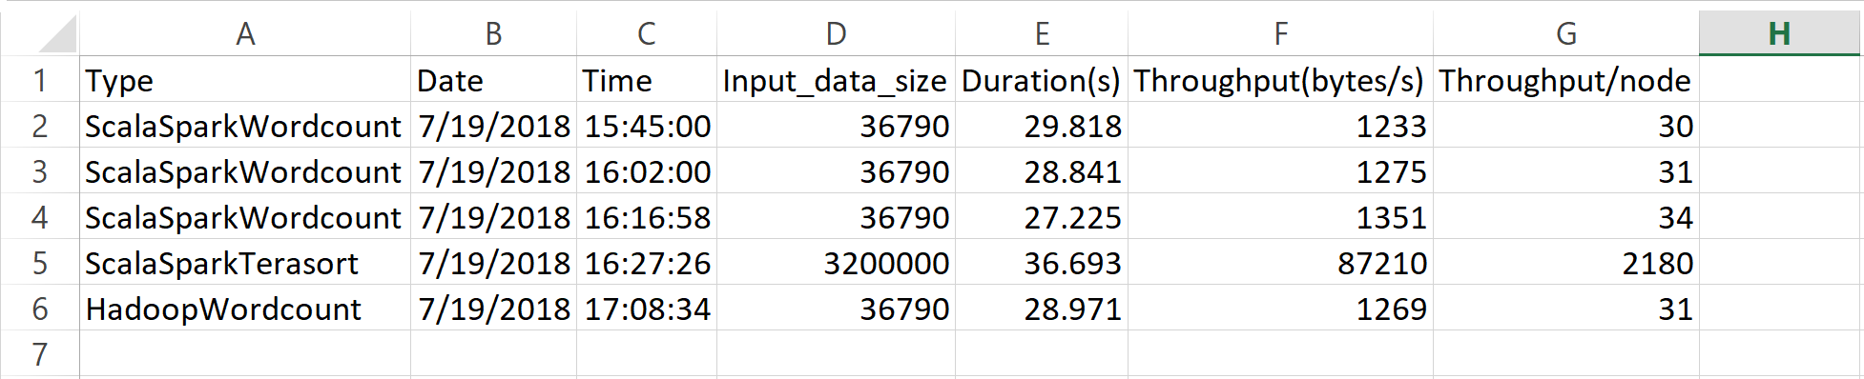
Automated Testing Tools
HiBench (Intel) - Measure speed, throughput, and system resource utilization
Micro benchmark workloads:
Sort, WordCount, TeraSort, Sleep, Enhanced DFSIO
SQL workloads:
Scan, Join, Aggregate
Machine Learning workloads:
Bayesian Classification, K-means clustering, Logistic Regression, Alternating Least Squares, Gradient Boosting Trees, Linear Regression, Latent Dirichlet Allocation, Principal Components Analysis, Random Forest, Support Vector Machine, Singular Value Decomposition
Websearch benchmark workloads:
PageRank, Nutch indexing
Graph benchmark workloads:
NWeight
Streaming workloads:
Identity, Repartition, Stateful Wordcount, Fixwindow
Supported releases: Hadoop: Apache Hadoop 2.x, CDH5, HDP Spark: Spark 1.6.x, Spark 2.0.x, Spark 2.1.x, Spark 2.2.x Flink: 1.0.3 Storm: 1.0.1 Gearpump: 0.8.1 Kafka: 0.8.2.2
Sample Output:

Slide 7
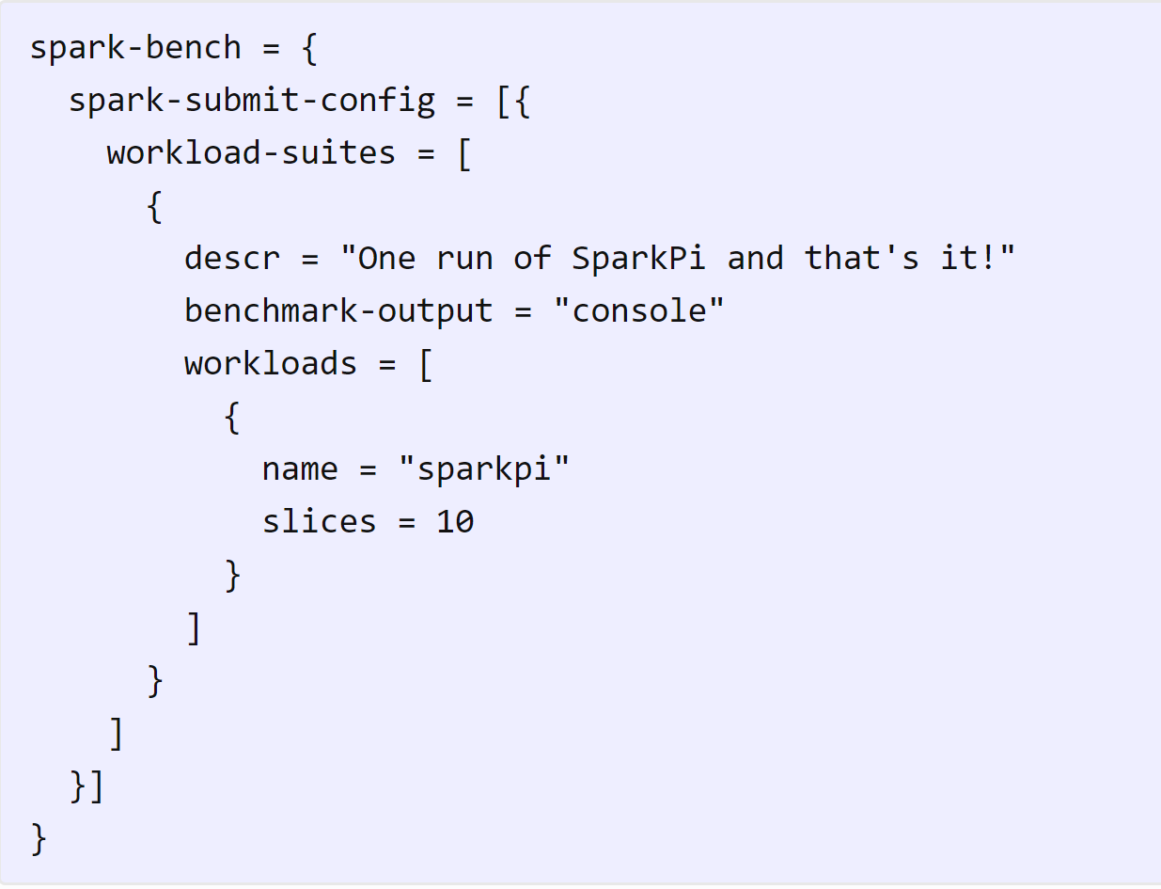
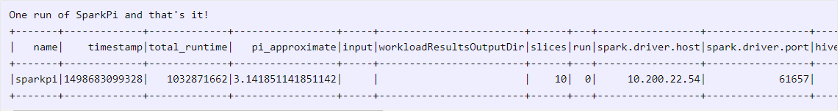
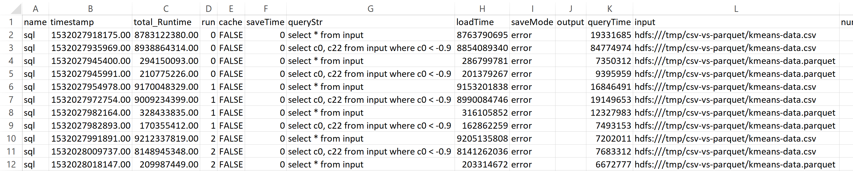
Automated Testing Tools
SparkBench (IBM) – Benchmarking and simulating Spark jobs
Spark-Submit-Config:
SparkBench converts config files into spark-submit scripts
Allows multiple spark-submits in series or parallel
Workloads:
Standalone Spark jobs with input/output
Data Generators: Graph, Kmeans, Linear Regression
Kmeans, Logistic Regression, Sleep, SparkPi, SQL
Workload Suites:
Collections of one or more workloads
Control benchmark output and parallelism
Custom Workloads:
Use Scala and SBT to build onto SparkBench
Test custom Spark libraries by including JAR
Sample Output:

Slide 8
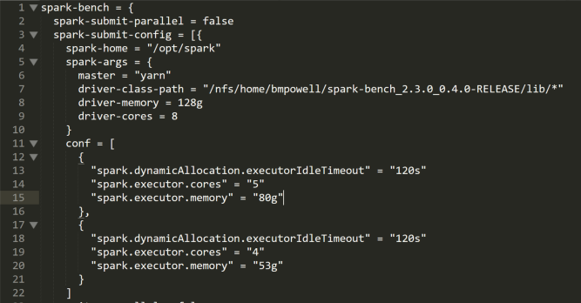
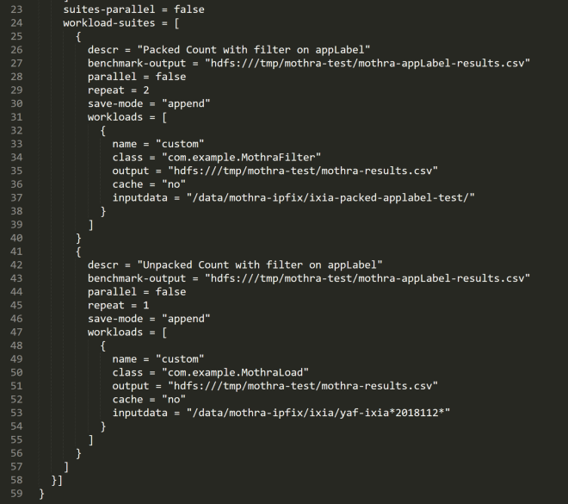
Automated Testing Tools
SparkBench Config Workload Definition
https://codait.github.io/spark-bench/

Slide 9
Automated Cluster Testing and Optimization
Mothra Refresher

Slide 10
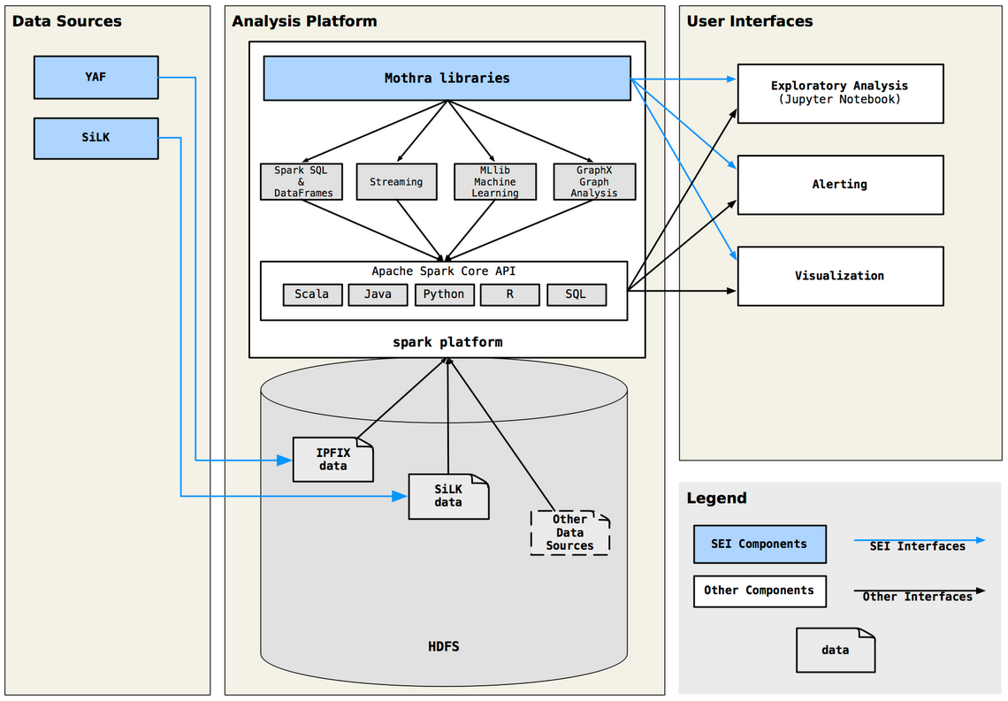
Mothra Refresher
Mothra Architecture
Facilitate bulk storage and analysis of cybersecurity data with high levels of flexibility, performance, and interoperability
Reduce the engineering effort involved in developing, transitioning, and operationalizing new analytics
Serve all major constituencies within the network security community, including data scientists, first-tier incident responders, system admins, and hobbyists

Slide 11
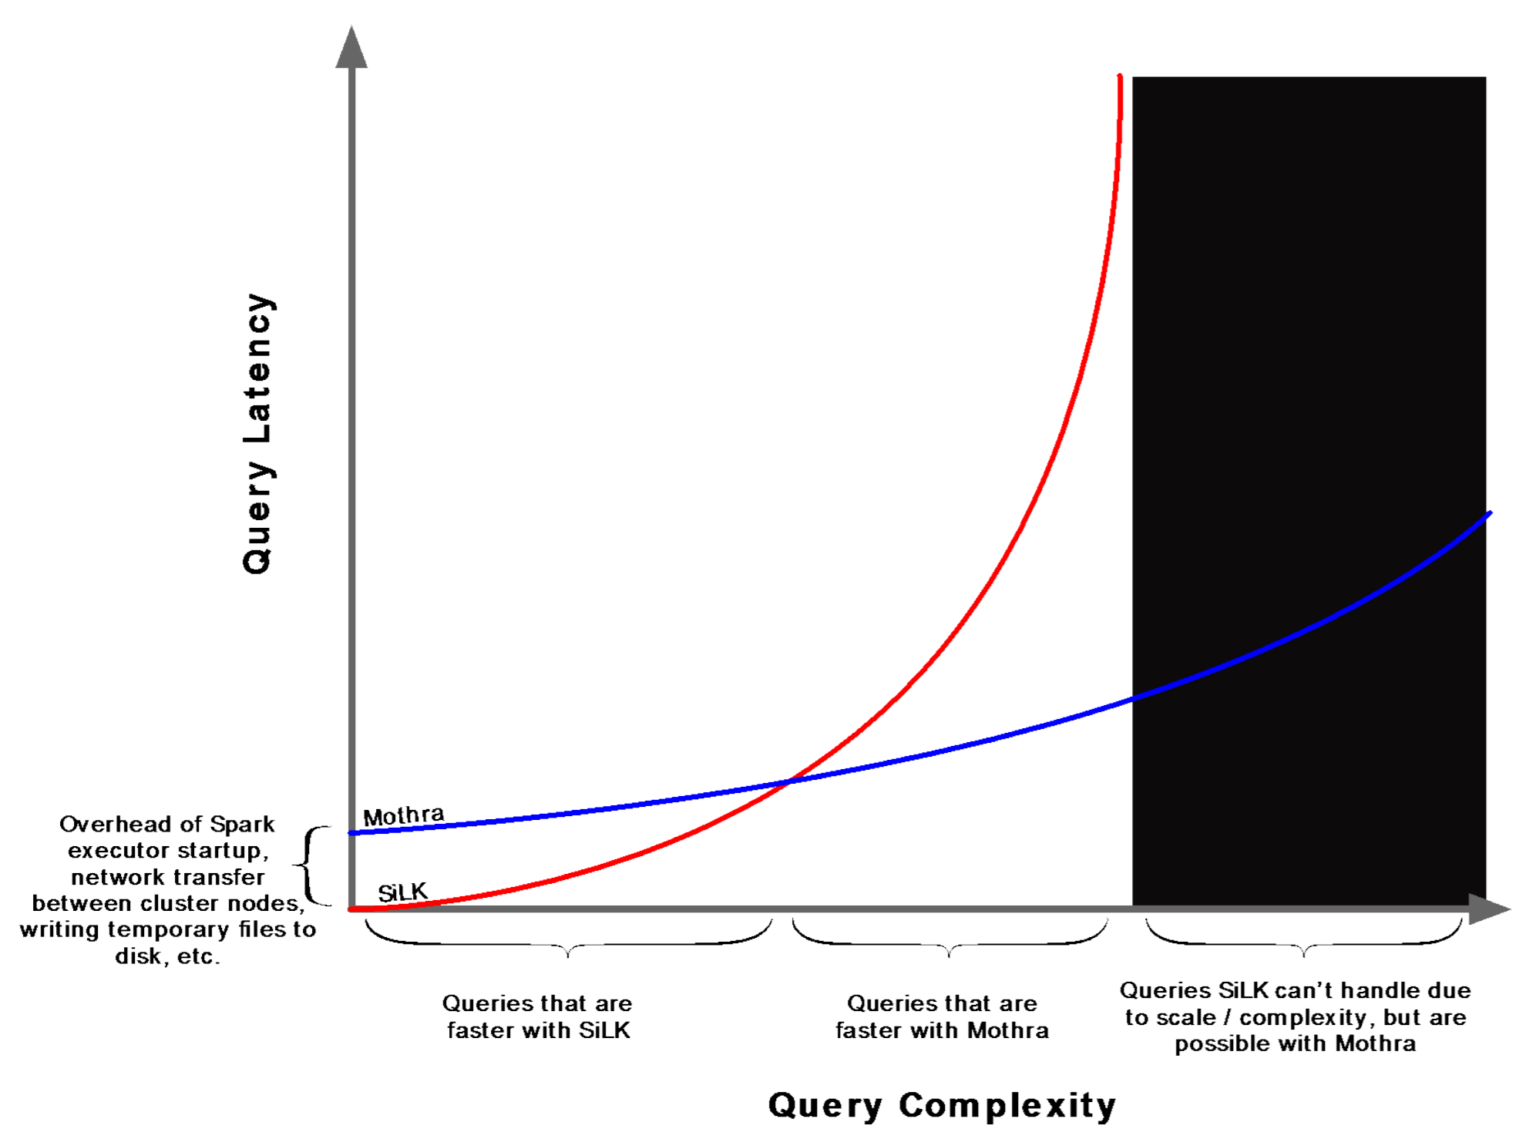
Mothra Refresher
SiLK vs. Mothra Scalability
Mothra enables more complex analyses at a scale beyond the capability of SiLK’s single-node architecture

Slide 12
Automated Cluster Testing and Optimization
Test Plan

Slide 13
Test Plan
The goal of our testing was to identify the performance and benchmarks for the DTE cluster in the following areas:
Cluster Operations using pre-built, Micro and Machine Learning Workloads.
Mothra Dataframe Creation and Spark Query Performance.
Mothra Ingest Process Performance running Collector and Packer processes on a 16 core physical edge node.

Slide 14
Test Plan
Test Environment Details
Number of Nodes: 40+10 Virtual nodes for NameNode, YARN Resource Manager, Zookeeper, and Edge Nodes
RAM: 256GB, Disks: 4 Disks - 600 GB, CPU: 2x8 cores
Network: Intel Corporation 82599ES 10-Gigabit dual port
HDP Version: HDP 2.6.4 YARN
Spark Version: Spark 2.2.1
Test parameters | Values
spark.submit.deployMode | client
spark.shuffle.service.enabled | true
spark.scheduler.mode | FIFO
spark.master | yarn
spark.executor.memory | 4g
spark.dynamicAllocation.minExecutors | 4
spark.dynamicAllocation.initialExecutors | 4
spark.dynamicAllocation.enabled | true
spark.driver.port | 36562
spark.driver.memory | 8g

Slide 15
Test Plan
HiBench Generated Data
Four groups: Large, Huge, Gigantic, and BigData
 | Large | Huge | Gigantic | BigData
Naïve Bayes | hibench.bayes.large.pages 100000 hibench.bayes.large.classes 100 hibench.bayes.large.ngrams 2 | hibench.bayes.huge.pages 500000 hibench.bayes.huge.classes 100 hibench.bayes.huge.ngrams 2 | hibench.bayes.gigantic.pages 1000000 hibench.bayes.gigantic.classes 100 hibench.bayes.gigantic.ngrams 2 | hibench.bayes.bigdata.pages 20000000 hibench.bayes.bigdata.classes 20000 hibench.bayes.bigdata.ngrams 2
Linear Regression | hibench.linear.large.examples 200000 hibench.linear.large.features 30000 | hibench.linear.huge.examples 300000 hibench.linear.huge.features 50000 | hibench.linear.gigantic.examples 500000 hibench.linear.gigantic.features 80000 | hibench.linear.bigdata.examples 1000000 hibench.linear.bigdata.features 100000
Random Forest | hibench.rf.large.examples 1000 hibench.rf.large.features 1000 | hibench.rf.huge.examples 10000 hibench.rf.huge.features 200000 | hibench.rf.gigantic.examples 10000 hibench.rf.gigantic.features 300000 | hibench.rf.bigdata.examples 20000 hibench.rf.bigdata.features 220000
K-means | hibench.kmeans.large.num_of_clusters 5 hibench.kmeans.large.dimensions 20 hibench.kmeans.large.num_of_samples 20000000 hibench.kmeans.large.samples_per_inputfile 4000000 hibench.kmeans.large.max_iteration 5 hibench.kmeans.large.k 10 hibench.kmeans.large.convergedist 0.5 | hibench.kmeans.huge.num_of_clusters 5 hibench.kmeans.huge.dimensions 20 hibench.kmeans.huge.num_of_samples 100000000 hibench.kmeans.huge.samples_per_inputfile 20000000 hibench.kmeans.huge.max_iteration 5 hibench.kmeans.huge.k 10 hibench.kmeans.huge.convergedist 0.5 | hibench.kmeans.gigantic.num_of_clusters 5 hibench.kmeans.gigantic.dimensions 20 hibench.kmeans.gigantic.num_of_samples 200000000 hibench.kmeans.gigantic.samples_per_inputfile 40000000 hibench.kmeans.gigantic.max_iteration 5 hibench.kmeans.gigantic.k 10 hibench.kmeans.gigantic.convergedist 0.5 | hibench.kmeans.bigdata.num_of_clusters 5 hibench.kmeans.bigdata.dimensions 20 hibench.kmeans.bigdata.num_of_samples 24000000000 hibench.kmeans.bigdata.samples_per_inputfile 40000000 hibench.kmeans.bigdata.max_iteration 10 hibench.kmeans.bigdata.k 10 hibench.kmeans.bigdata.convergedist 0.5

Slide 16
Test Plan
Ixia Simulated IPFIX datasets
Filename(s) | Size | Record Count | Bytes per Flow | Description
/data/mothra-ipfix/live/ipfix-live-s1-20180820000030-00268.yaf | 1.66 MB | 8,746 | 189.80 | 1 hour of live ipfix data from DTE YAF sensor on 8/20
/data/mothra-ipfix/ixia/yaf-ixia-napa_lb0-20180819000021-00110.yaf | 3.17 GB | 21,997,654 | 144.11 | 1 hour of Ixia generated ipfix data for 1 YAF sensor on 8/19
/data/mothra-ipfix/ixia/yaf-ixia-napa_lb*-20180819000021-00110.yaf | 22.19 GB | 154,038,796 | 144.05 | 1 hour of Ixia generated ipfix data for 8 YAF sensors on 8/19
/data/mothra-ipfix/ixia/yaf-ixia-napa_lb*-20180819*.yaf | 597.61 GB | 4,159,659,052 | 143.67 | 24 hours of Ixia generated ipfix data for 8 YAF sensors on 8/19
/data/mothra-ipfix/ixia/yaf-ixia-napa_lb*-2018081*.yaf | 3.08 TB | 21,772,346,751 | 141.46 | 5.5 Days of Ixia generated ipfix data for 8 YAF sensors on 8/14-8/19
Filename(s) | Size | Record Count | Bytes per Flow | Description
/data/mothra-ipfix/ixia/yaf-ixia-napa_lb7-20180922110219-00274.yaf | 263.78 MB | 1,088,294 | 254.15 | 5 minutes of Ixia generated ipfix data for 1 YAF sensor on 9/22
/data/mothra-ipfix/ixia/yaf-ixia-napa_lb*-20180922110219-00274.yaf | 2.06 GB | 8,693,166 | 254.22 | 5 minutes of Ixia generated ipfix data for 8 YAF sensors on 9/22
/data/mothra-ipfix/ixia/yaf-ixia-napa_lb7-2018092211* | 3.11 GB | 13,199,568 | 252.92 | 1 hour of Ixia generated ipfix data for 1 YAF sensor on 9/22
/data/mothra-ipfix/ixia/yaf-ixia-napa_lb*-2018092211* | 24.89 GB | 105,639,034 | 253.00 | 1 hour of Ixia generated ipfix data for 8 YAF sensors on 9/22
/data/mothra-ipfix/ixia/yaf-ixia-napa_lb*-2018092* | 605.74 GB | 2,628,246,577 | 247.47 | 24 hours of Ixia generated ipfix data for 8 YAF sensors on 9/22

Slide 17
Test Plan
Automated Custom SparkBench Testing
Operation | Query
Build IPFIX DataFrame (mothra), Count | val input_data_ixia = "/data/mothra-ipfix/ixia/yaf-ixia-napa_lb*-20180815*.yaf" val input_df = (spark.read. fields( "sIP", "dIP", "sPort", "dPort", "protocol", "packets", "bytes", "startTime", "endTime", "dnsQName" -> "ipfix:yaf_dns/yaf_dns_qr/dnsQName", "dnsQAddr" -> "ipfix:yaf_dns/yaf_dns_qr/yaf_dns_a/sourceIPv4Address" ) .ipfix(input_data_ixia ) input_df.count()
Simple Filter (Spark), Count | var dns_flows = input_df.filter($"dport" === 53) dns_flows .count()
Column Selection & Display (Spark) | https_flows = input_df.filter($"dport" === 443).select( "sip", "dip", "sport", "dport", "protocol", "packets", "bytes", "sslCertificateHash") https_flows.count()
Sorting (Spark) | https_flows.sort($"bytes".desc).show()
Aggregation (Spark) | https_flows. groupBy($"dip"). avg("packets", "bytes"). sort($"avg(bytes)".desc).count()
SQL Query (SparkSQL) | input_df.registerTempTable("df") spark.sql("""SELECT dnsQName, AVG(packets) AS avg_packets, SUM(packets) AS sum_packets, AVG(bytes) AS avg_bytes, SUM(bytes) AS sum_bytes FROM df WHERE dnsQName IS NOT NULL GROUP BY dnsQName ORDER BY sum_bytes DESC""").count()
Compound Query w/ Join, Filter, & Select (SparkSQL) | val bad_names = spark.read.parquet("/user/tonyc/data/sample/bad_dns_names.parquet") var bad_addrs = ( dns_flows .join(bad_names, $"dnsQName" === $"name") .select("dnsQAddr") .distinct).toDF("addr") val pwned = input_df.join(bad_addrs, $"dIP" === $"addr").drop("addr") pwned.count()

Slide 18
Automated Cluster Testing and Optimization
Results and Tuning

Slide 19
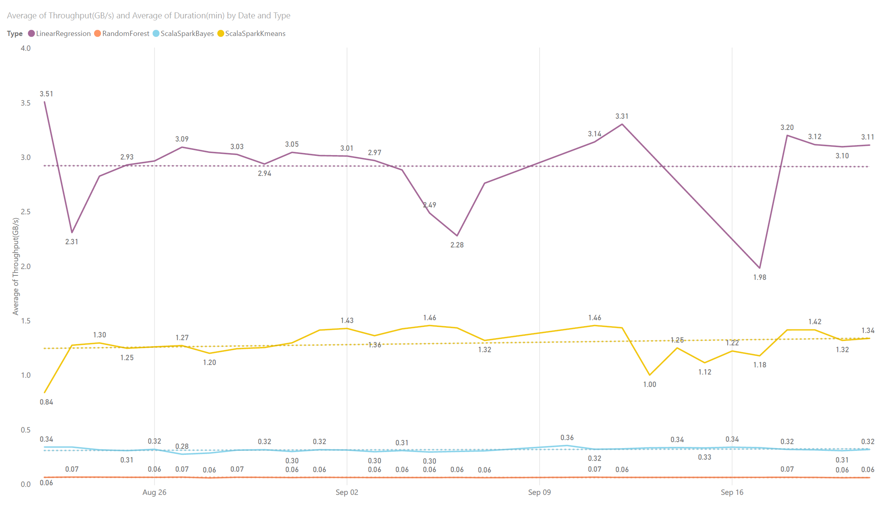
Results and Tuning
Operational ML Workloads
Machine Learning workloads benchmark average throughput in GB/s over one month

Slide 20
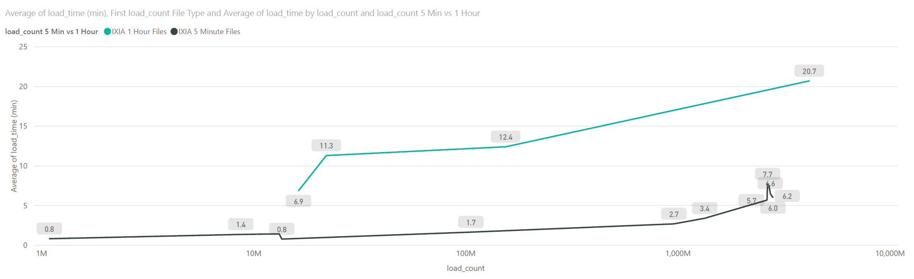
Results and Tuning
SparkBench Custom Mothra Workloads
Mothra Dataframe load time in minutes by input file record count and file size below. Graphs shows two different raw, unpartitioned file schemes. Green is one file per hour of data and black is twelve files per hour of data. There is a significant performance improvement when files are collected every five minutes vs. one hour.

Slide 21
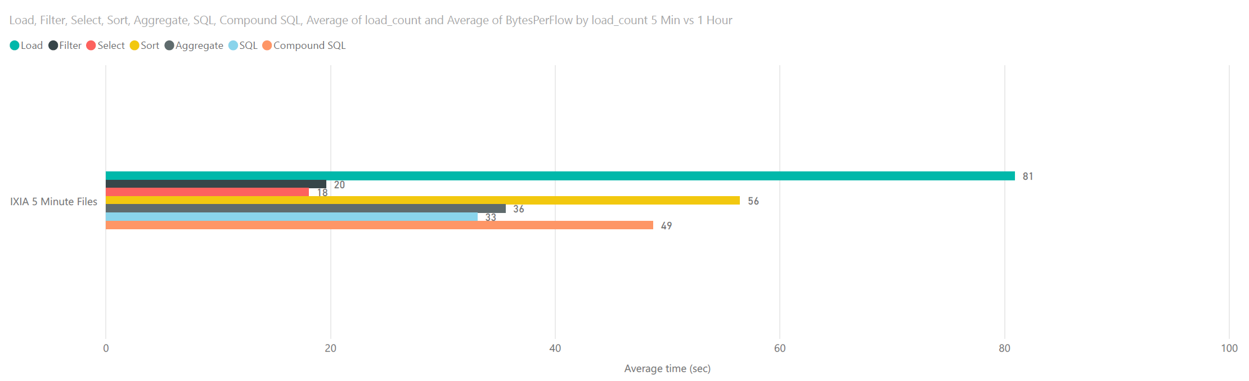
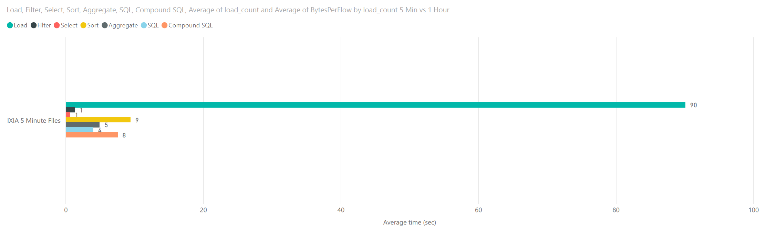
Results and Tuning
SparkBench Custom Mothra Workloads
Spark Submit completion times in seconds for Mothra and Spark queries. Graph is comparing equivalent data sets with one file per hour vs twelve files per hour. Caching in the second chart adds some overhead during load, but there is significant improvement in subsequent tasks reducing average processing time for all workloads from 293 seconds to 118 seconds a 60% improvement.

Slide 22
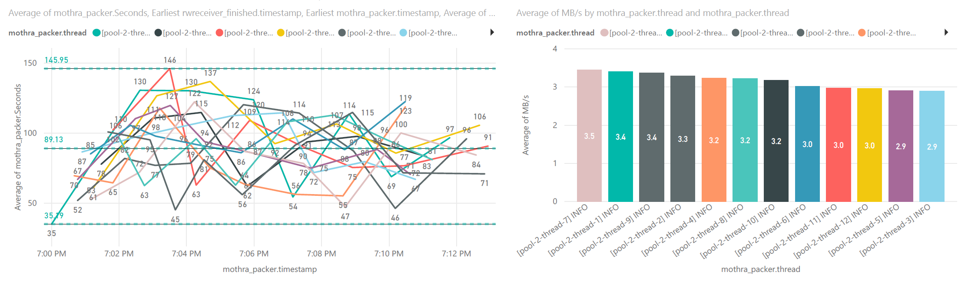
Results and Tuning
Mothra Packer Testing
Load times and throughput for Mothra Packer. Two sample runs of 12 max pack jobs on a 16 core physical edge node. Rwsender landed 96 files (1 hour) at once with an average of ~271 MB per file (91,346,434 records). The average throughput per process is ~3MB/s. Adding polling and flush overhead, the average of total throughput is ~27MB/s

Slide 23
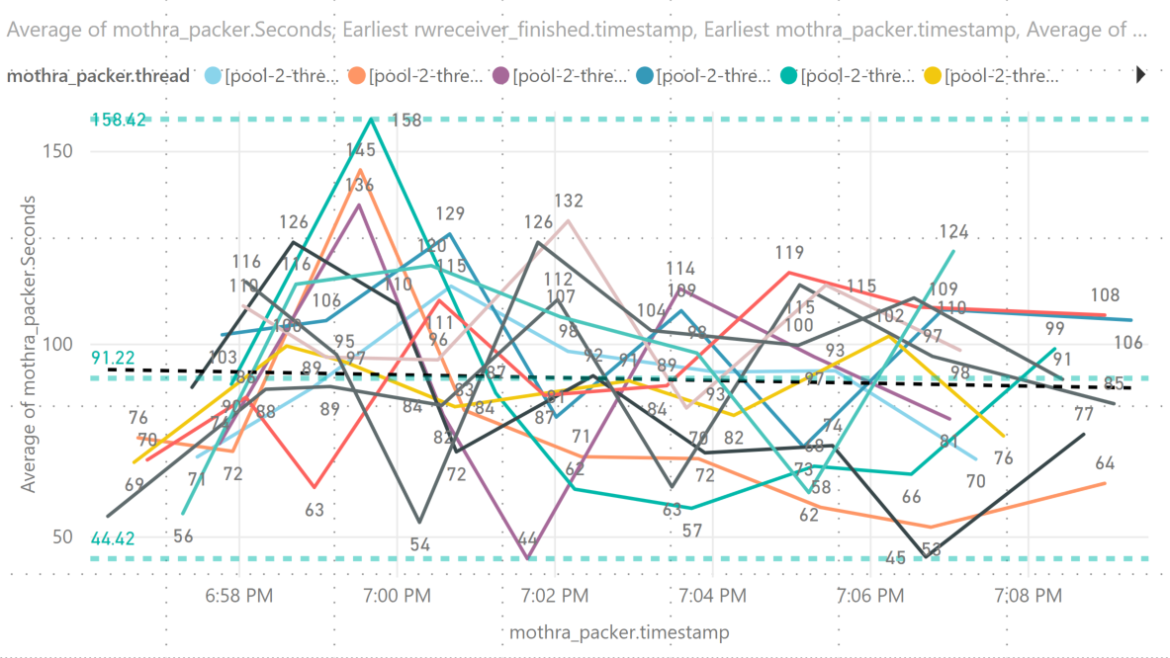
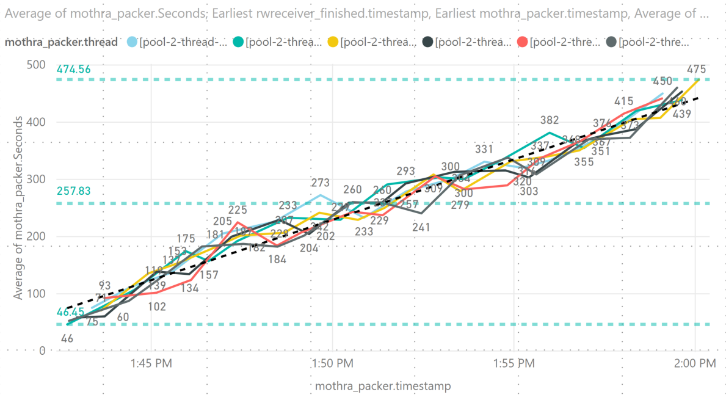
Results and Tuning
Mothra Packer Testing
Two sample runs 16 core edge node. Rwsender landed 96 files (1 hour) at once with an average of ~271 MB per file (91,346,434 records). The black dashed line shows the trend of completion time of each pack job.
Test (a) shows a flat trend line which means that the jobs are keeping up with the files landing from rwsender while test (b) shows an incline trend which means that jobs are slowing over time and not able to keep up with the file ingestion. In both cases, one hour of our test data was packed in under 20 minutes, but test (a) should maintain this speed with more load, while test (b) would continue to slow as more files are landed. (a) 12 Max Pack Jobs (b) 6 Max Pack Jobs

Slide 24
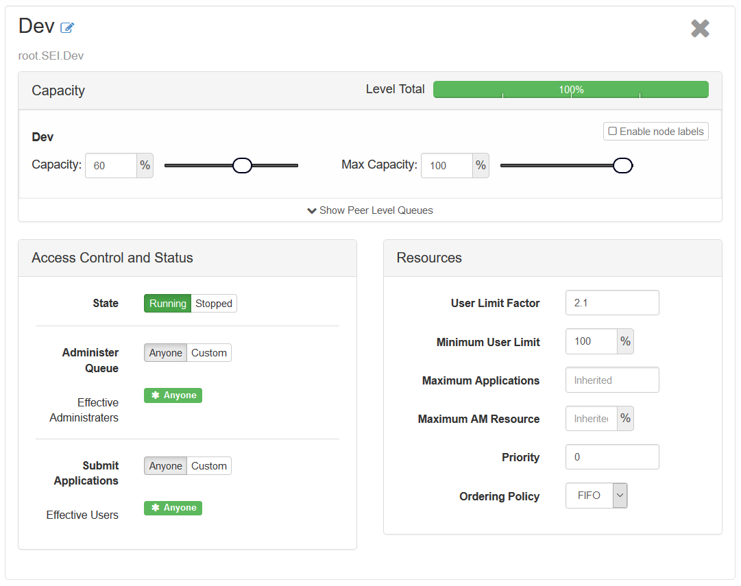
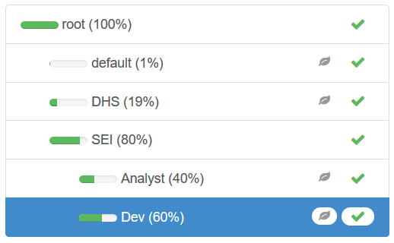
Results and Tuning
YARN Queue Manager / Capacity Scheduler
Certain settings needed to be changed to take full advantage of the cluster resources and utilize dynamic allocation in Spark. Capacity and Max Capacity are not intuitive and only relate to the queue, not the whole cluster. In order to use resources beyond the queue (80% * 60% = 48%) , User Limit Factor needs to be set above 1.
Depending on the number of users, Minimum User Limit and Ordering Policy can be used to avoid conflicts among analysts for cluster resources.

Slide 25
Results and Tuning
Spark Tuning
Executor Cores
Typically no more than 5 cores can achieve full write throughput to HDFS
Setting cores too low (tiny executors) for large jobs on large clusters will cause garbage collection and out of memory errors
With executor-cores > 1, the DominantResourceCalculator must be selected for YARN
Executor Memory
Calculated based on cluster size and executor-cores (Example = 6 nodes, 16 cores/node, 64gb memory/node, 5 executor-cores)
yarn.nodemanager.resource.cpu-vcores * total cluster nodes = total available cores | 15 * 6 = 90 total available cores
total available cores / executor-cores = total available executors | 90 / 5 = 18 total available executors
total available executors / total cluster nodes = number of executors per node | 18 / 6 = 3 number of executors per node
yarn.nodemanager.resource.memory-mb / number of executors per node = memory per executor | 63 / 3 = 21 memory per executor
memory per executor * (1 - spark.yarn.executor.memoryOverhead) = roundDown(executor-memory) | 21 * (1 - .07) = roundDown(19.53) = 19 GB = executor-memory

Slide 26
Results and Tuning
Spark Tuning
Dynamic Allocation Executor Idle Timeout
This option controls when executors are removed once idle.
Losing an executor due to a timeout and starting a new one adds additional overhead to a spark job.
For some use cases, such as exploratory analysis in Jupyter or Zeppelin, the default timeout of 60s might be too short.
Finding the ideal value for this, per use case, will require an iterative process between system administrators, cluster developers, and analysts.

Slide 27
Automated Cluster Testing and Optimization
Questions?
Contact
bmpowell@cert.org

